Slide 1
What Makes People Happy?
Lauren Gardner, Danica Tiegs, Stacey Wai, Siara Leininger and Courtney Muhlbach

Slide 2
Main Question
What factors play into how happy a general population is?
Specifically, can we use data on alcohol consumption, health, and other social factors to predict how happy people in specific countries are?

Slide 3
Data Sources Used
We pulled data about various countries from the following locations:
World Health Organization (WHO) - Global Information System on Alcohol and Health
World Health Organization (WHO) – Life Expectancy and Health Data
Gallup Word Poll (GWP) – Happiness

Slide 4
Methods Explored
Unsupervised Learning
Method: Clustering
Goals:
Explore the data
Identify groups
Find trends in each group
Supervised Learning
Method: Multiple Linear Regression
Goals:
Determine which features impact happiness

Slide 5
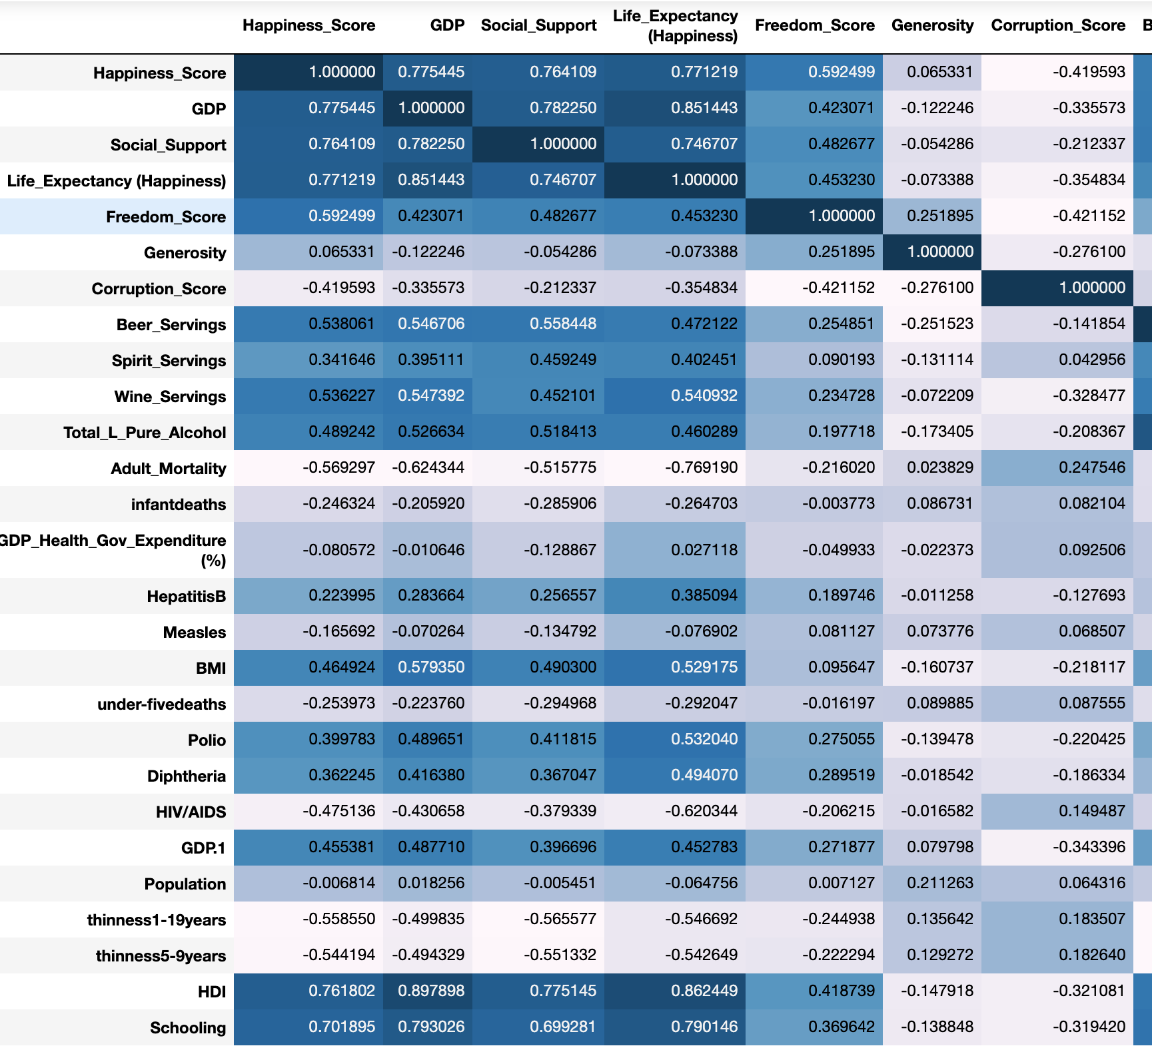
Correlation Matrix

Slide 6
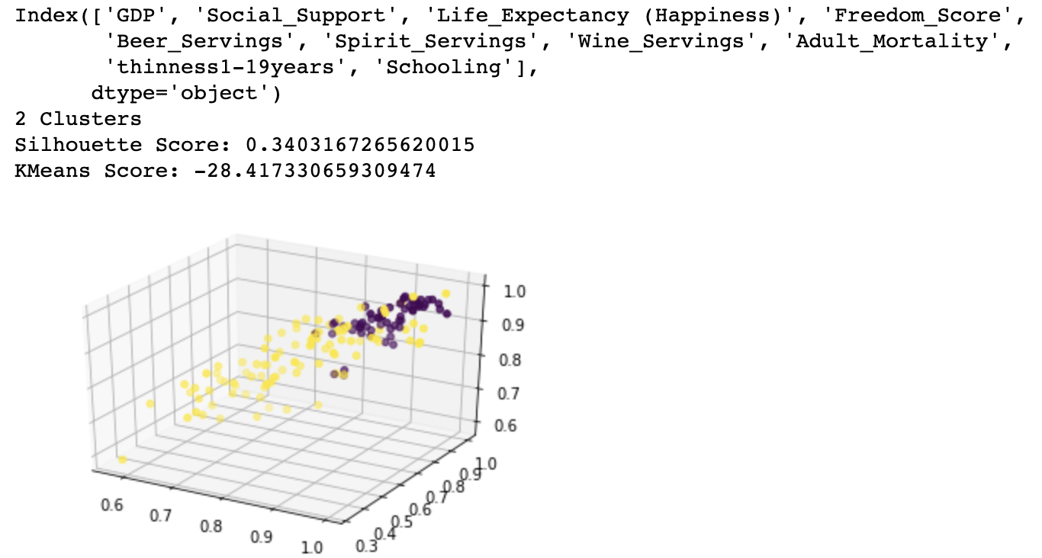
Clustering

Slide 7
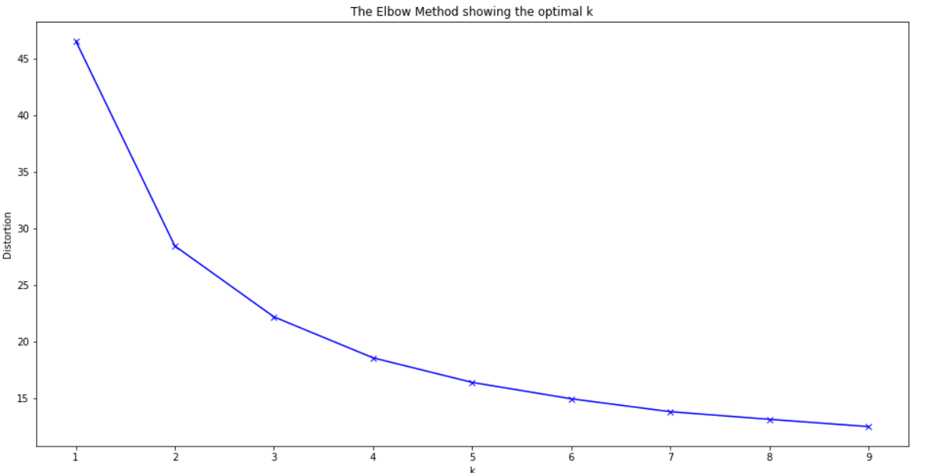
Elbow Method
Concave part of the elbow determines the clusters needed

Slide 8
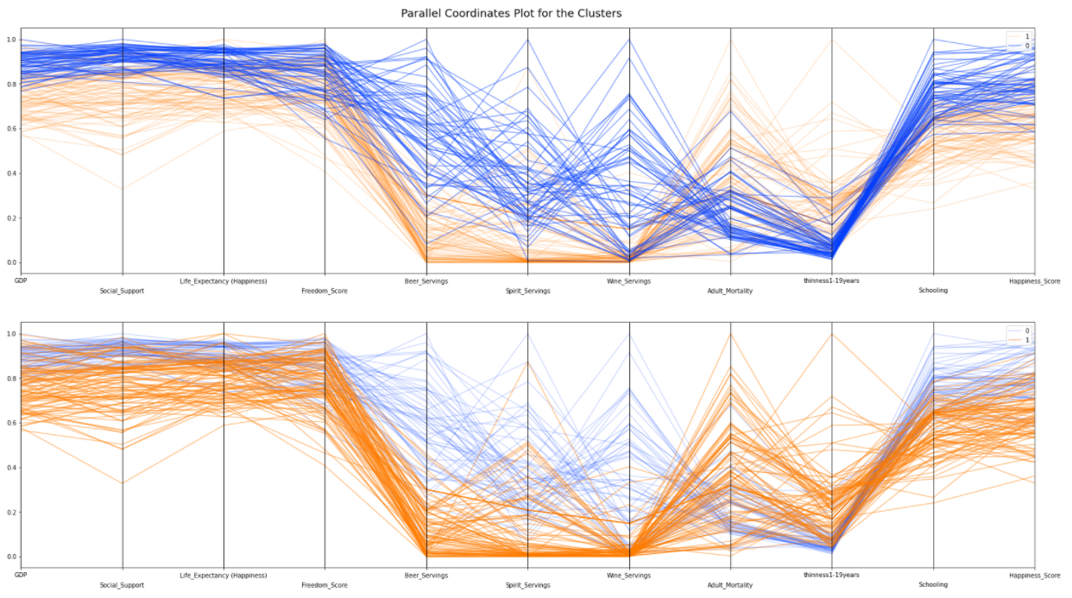
Parallel Coordinates
Maps the centroid of each cluster

Slide 9
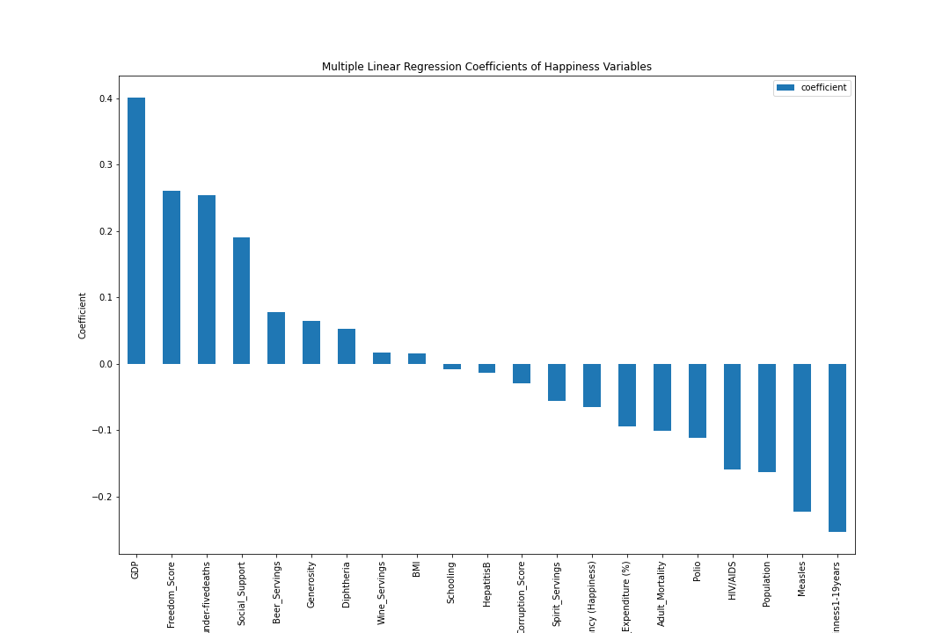
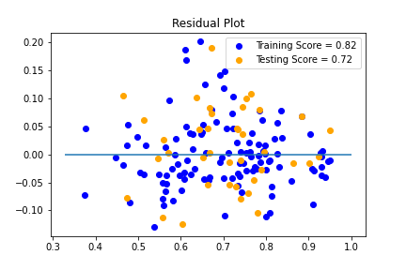
Multiple Linear Regression
Notes:
Positive - GDP, Freedom, <5 Deaths, Social Support
Negative - Thinness 1-19 years, Measles, Population, HIV/AIDs, Polio, Adult Mortality

Slide 10
Conclusions
Questions?

